Slide 1
ITU AI/ML in 5G challenge: ITU-ML5G-PS-004
Presentation Title : Depth Map Estimation in 6G mmWave systems
Team Name: SixG_ISAC
Team Github Repo: ITU-AI-ML-in-5G-Challenge/ML5G-PS-004-Depth-map-estimation-in-6G-mmWave-systems
Team Members:
Shubham Khunteta
Yeswanth Reddy Guddeti
Avani Agrawal
Ashok Kumar Reddy Chavva
Affiliation : Beyond 5G Team, Samsung R&D Institute India, Bengaluru.
Problem Organizer: NIST, USA.
Notes:
Hello everyone, (hope you had an good time attending the presentations so far). I am Yeswanth reddy from Samsung research institute in Bangalore. Our team SixG_ISAC has four members, myself, shubham, avani and ashok .
And we work on applications that go beyond 5G.
To support a large variety of such applications we need a network that is not just fast but also one that is flexible with intelligence to adapt to each of these applications .
In this challenge, Our goal is to develop a machine learning framework for one of these applications i.e estimation of depth map of the environment using 6G communication signals.

Slide 2


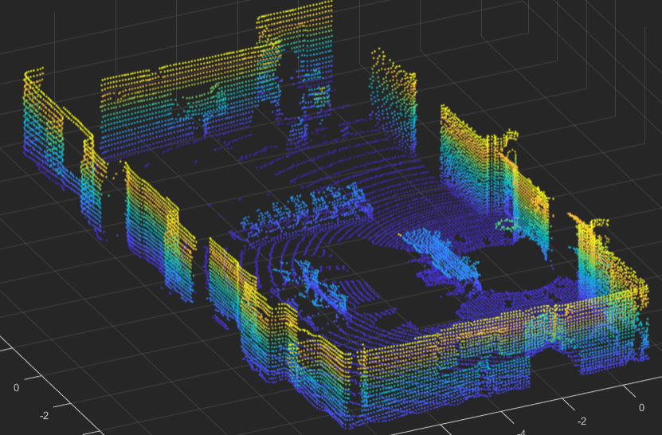
Motivation : Communication waves to create Digital world
Integrated Sensing & communications
Physical world
Digital world
ISAC + AI/ML
Inference using RF communication signal
Reuse spectrum, devices and protocols to perform both communication and sensing.
Extra processing required to acquire multi-dimensional data
Notes:
Integrated sensing & communications or ISAC in short uses existing Communication infrastructure like spectrum, devices and protocols to perform both communication and sensing.
There has been lot of literature in this area where inferences were made on signal distortions to detect location ,movement & even orientation of people & obstacles.
-----Transition------
The next step envisioned in this direction is creating digital twin of the physical world . This digital twin can then be used to solve problems like beam selection virtually without ever sending actual beams in physical environment.
On the other hand, Creating a digital twin using RF signals implies sensing a whole room having hundreds of objects . Therefore We can no longer rely only on the handcrafted features for inferences as this problem is of higher complexity & scale.
We also need to perform extra processing to obtain multi dimensional data from RF signals.
(How MIMO vs LIDAR different ??? ADD pros vs CONS : low light,NLOS)
Traditionally this depth map has been done using LIDAR & camera. So we need to train a model with large enough training set with RF signals as input and lidar or camera data as ground truth.
Thanks to measurement setup from NIST which has RF, lidar sensors mounted on a Robot , we have been provided with data from multiple locations across a conference room.
Now moving onto the solution, I will be handling the first half of the presentation explaining the problem statement and the pre-processing of the RF data before it goes into the ML model. Shubham will then explain the ML model architecture, training and the results.

Slide 3
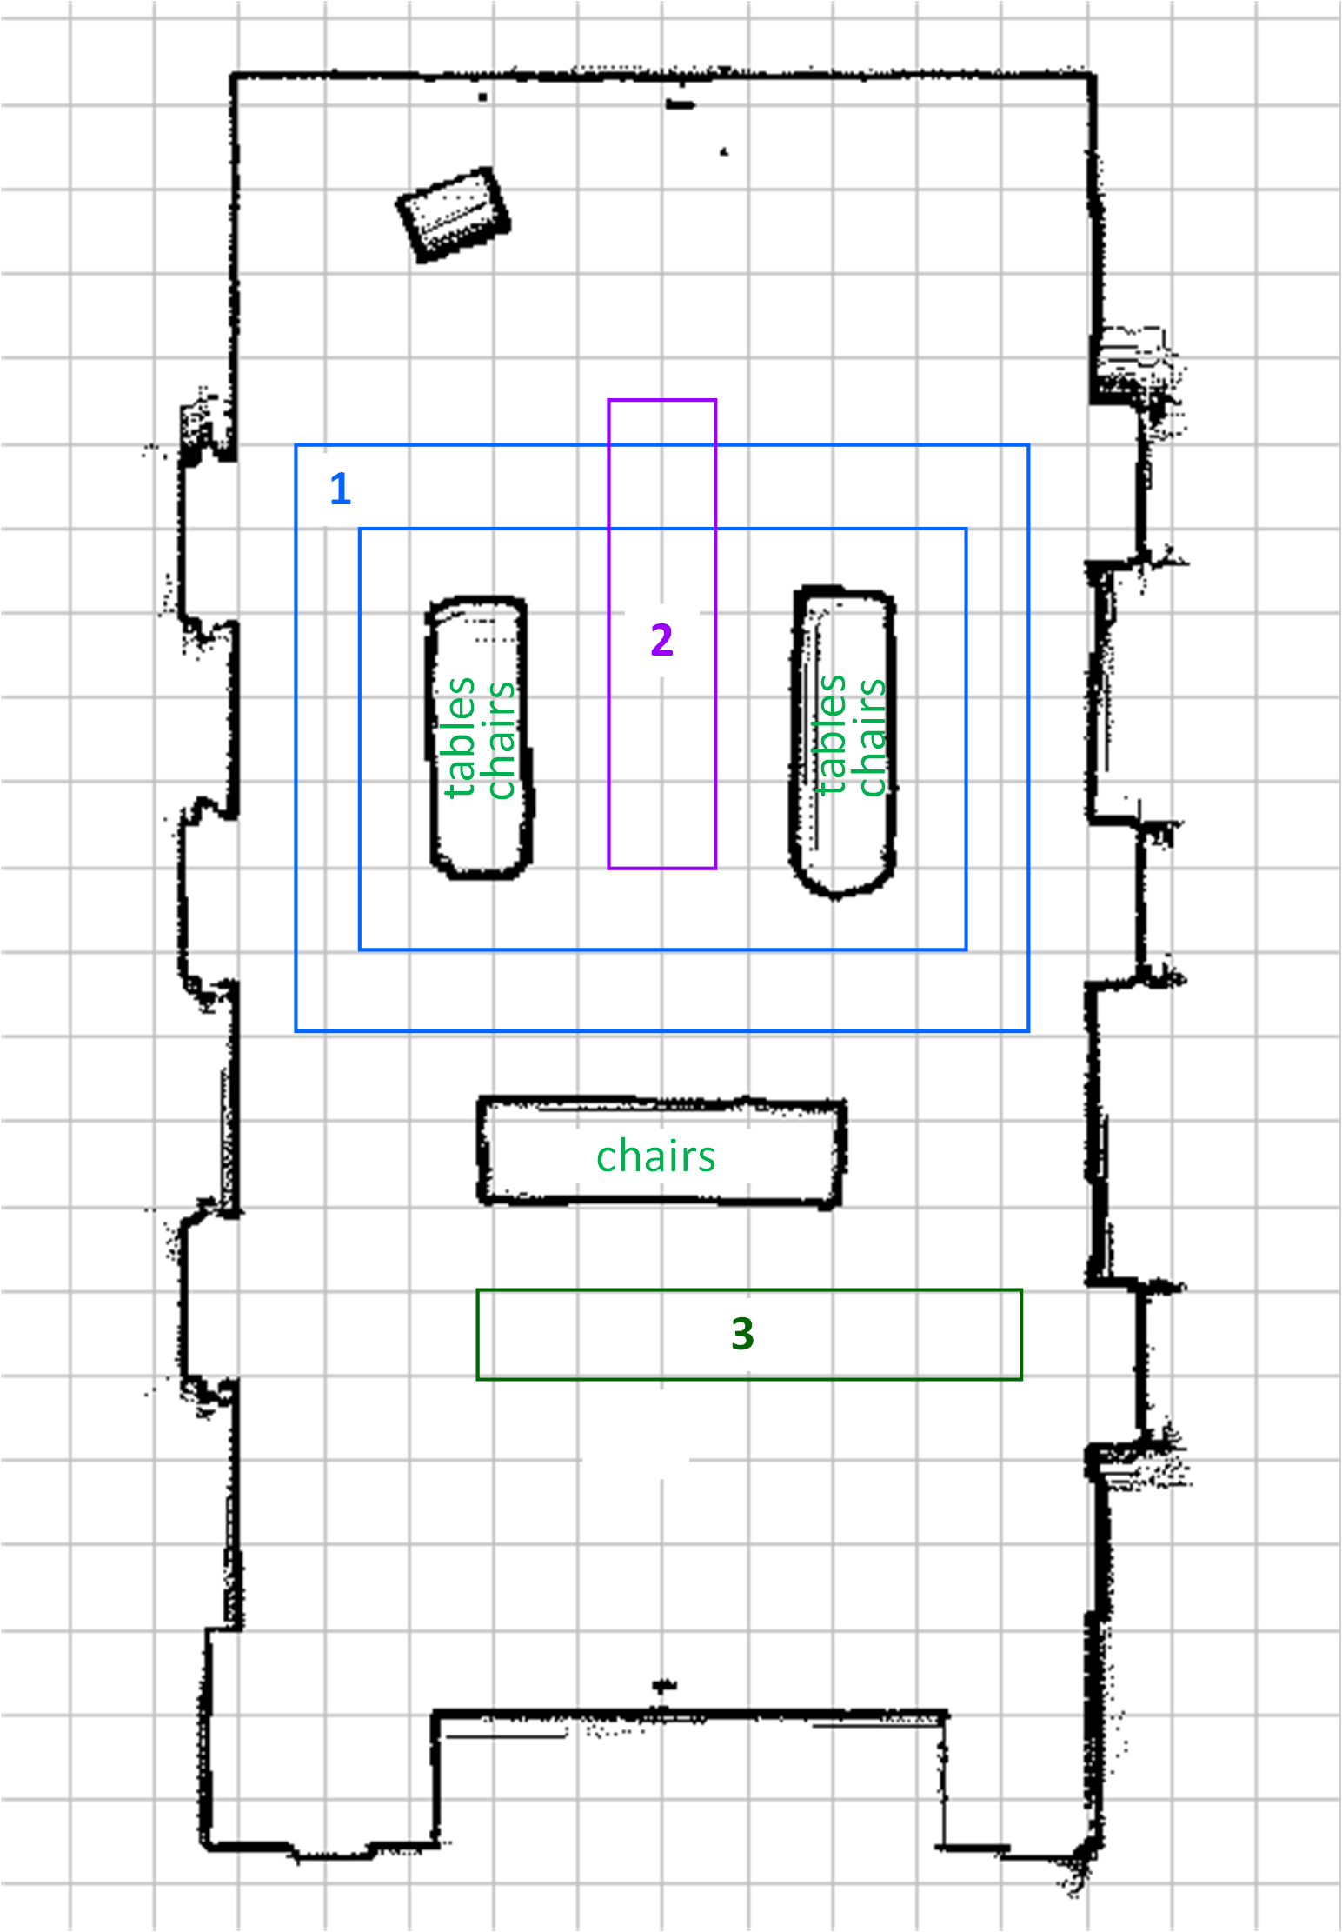
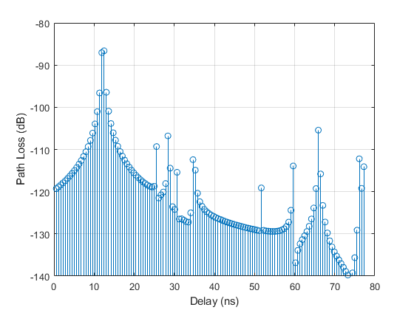
Problem statement
Problem statement
RX
Setup :
One fixed transmitter
One moving receiver
TX
ML Model :
Channel Impulse response
Input Data:
Training RF Dataset
Trained Model
Output: LiDAR Point Clouds
Challenge : Estimate the depth map of the environment at each receiver position, using mm-wave signals + ML.
Notes:
Lets take a look at the measurement setup. This is the room in which measurements are taken. (laser pointer)
We have a transmitter at a fixed location on the left and a receiver moving in different areas of room . Observation of the room changes with receiver location & orientation.
-----Transition------
The challenge is to estimate depth map of the environment at each receiver position using mmwave signals.
-----Transition------
In other words , We train an ML model that takes MIMO channel impulse response as input and generates Lidar point cloud as the output.

Slide 4
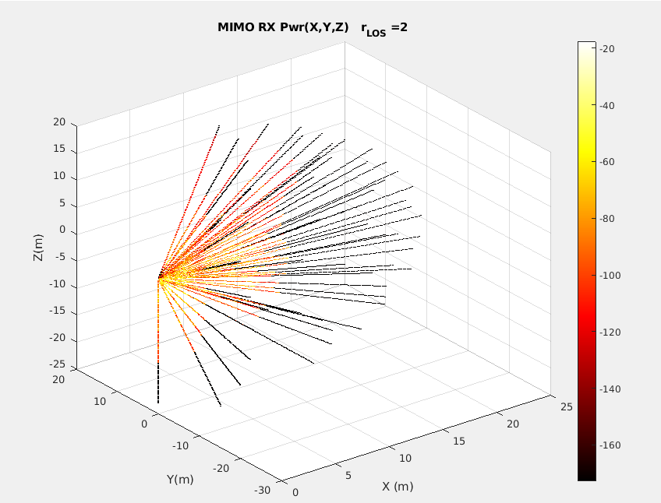

Solution outline
Input Data:
Training RF Dataset
Pre-processing
TX
RX
RX
Trained ML Model
Ground Truth:
Training LiDAR dataset
TX/RX
Solution : At each RX location
Transform bi-static RF data to mono-static format.
Train ML model by fitting it to similarly structured LiDAR ground truth.
Notes:
Now coming to outline of solution.
The input RF data has the transmission & reception at physically seperate locations also known as bi static mode. Whereas Lidar sends and receives laser signals from the same location also known as mono-static mode.
-----Transition------
So Pre-processing step handles the deterministic aspects of transforming MIMO channel data which is in bistatic format to mono-static format. This makes ML model learning faster & understandable.
-----Transition------
Looking at the input data at each location, we observed
that RF data has lower resolution & fewer reflections (with 6400 points) whereas Lidar has both higher resolution & larger points of reflections (approximately 32,000 points).
-----Transition------
So at each RX location,
We transform the bistatic RF data into mono-static format
And train the ML model by fitting it to similarly structured Lidar ground truth.
--------end--------------
As you can see,
In essence, we are attempting to take MIMO channel data that is bi-static (physically separable TX, RX) and fit it to LIDAR data that is mono static (same antenna as TX & RX).
(Why do you need to transform to mono static data before sending to ML?
We wanted to make the training part of model more simpler & explainable . If not done, model should be itself learn about existence of MIMO TX and its location and other features thorough a large amount of training data which is of-course not guaranteed and depends on ML architecture.)
(In addition, we wanted to handle the deterministic aspects of model fitting like data transformations outside the DL model training.
Since we are aware of what part of model learns what? this makes improving the overall model with further additional features much easier.)

Slide 5
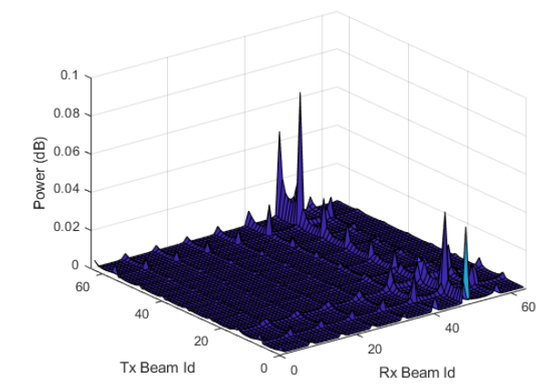
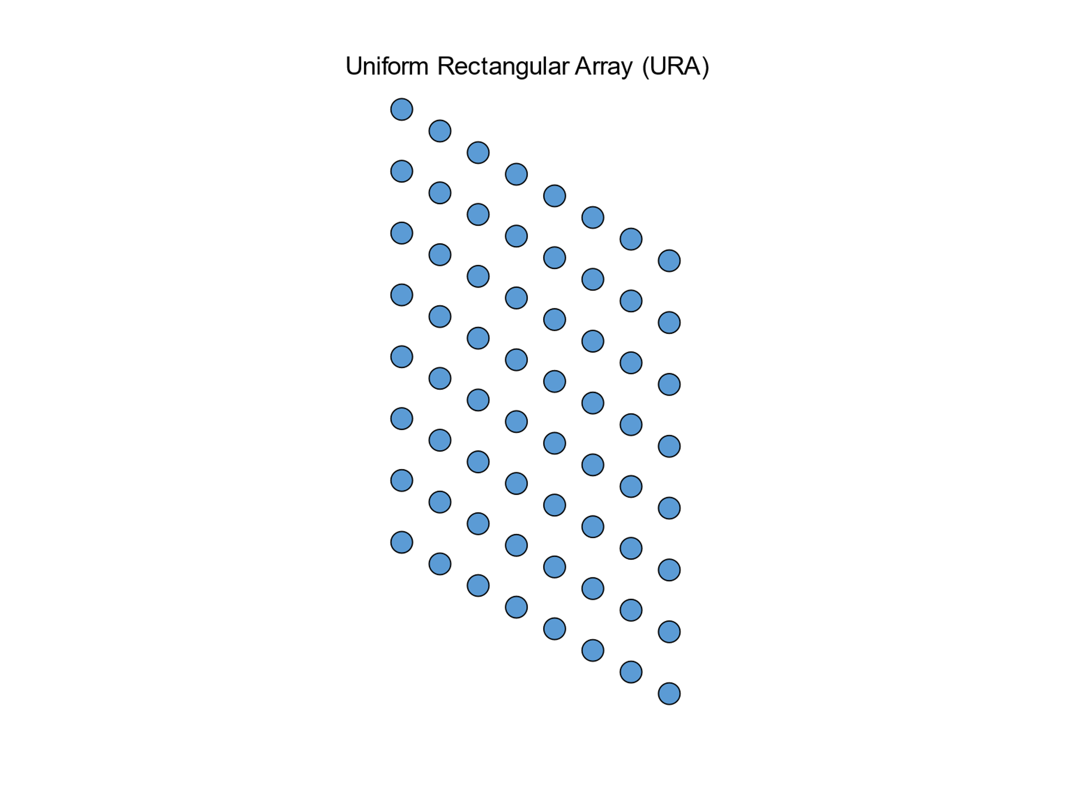
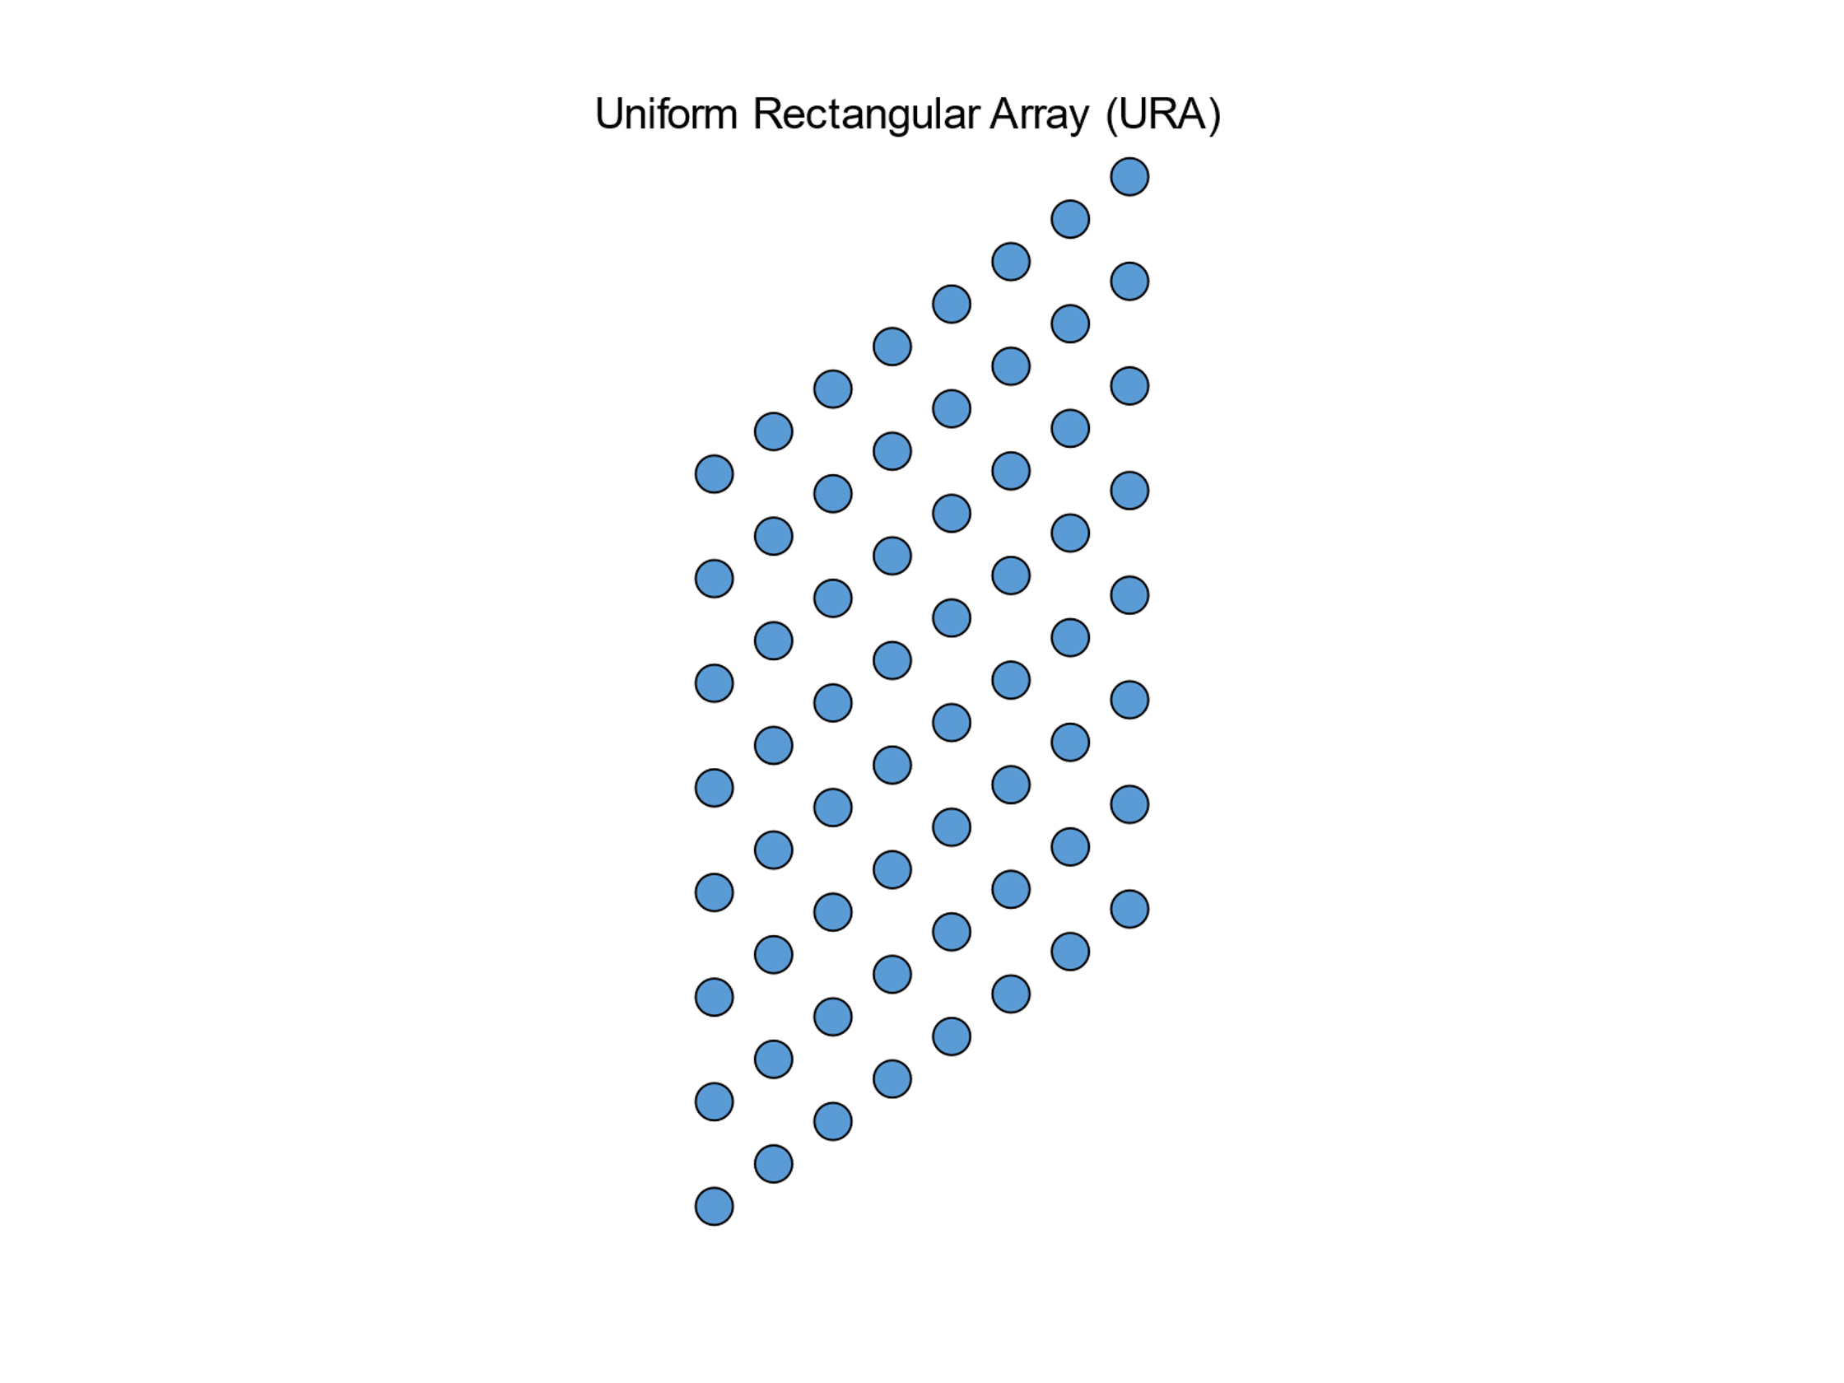

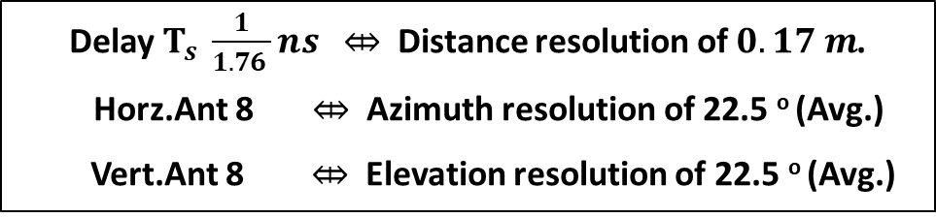


Pre-processing : Spatial Transform
Channel Impulse response
8×8
8×8
$$H_{CIR}$$
TX Ant x RX Ant x time
$H_{CIR}$
Spatial transform
$H_{beam}$
(TX Ant x RX Ant x Delay)
(AOD x AOA x Delay)
Delay $T_{s} \frac{1}{1.76 }ns \text{⤄}$ Distance resolution of $0.17 m$.
Horz.Ant 8 $\text{⤄}$ Azimuth resolution of 22.5 º (Avg.)
Vert.Ant 8 $\text{⤄}$ Elevation resolution of 22.5 º (Avg.)
Transforms Communication data to Sensing framework
Notes:
First step in pre-processing to perform spatial transform on the input channel impulse response. This is done so that we can transform our data from Antenna space to angular beam space.
-----Transition------
This spatial transform therefore helps us get to sensing framework from communication framework.
-----Transition------
The matrix H_beam gives us the power of reflections at different points separated in distance by 0.17 m or 17 cm & angular res of 22.5 deg in azimuth & elevation

Slide 6
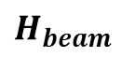

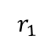
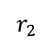
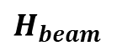
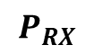

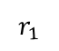
Pre-processing : Spatial Transform
$H_{CIR}$
Spatial transform
$H_{beam}$
$$r_{2}$$
$$r_{1}$$
TX
$H_{beam}$
(AOD x AOA x Delay)
$$r_{1}$$
$P_{RX}$
$$P_{RX}$$
Notes:
Now that we got H_beam, we need to transform it into mono-static format i.e to make it look as if the transmission & reception occur at RX.
The first step in this transformation is to Find LOS path

Slide 7
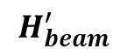
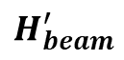
Pre-processing : Find LOS
$H_{CIR}$
Spatial transform
$H_{beam}$
$$r_{2}$$
$$r_{1}$$
1 : Find LOS
TX
$H_{beam}^{′}$
$H_{beam}$
$$H_{beam}^{′}$$
(AOD x AOA x Delay)
Select (TX,RX) Beam with
Higher Power
Lower Delay
Tighter Beamwidth
$$r_{1}$$
$P_{RX}$
$$P_{RX}$$
Remove LOS from $H_{beam}$ & Store LOS parameters
Notes:
------- Transition------
We take the matrix H_beam and find the beam which has highest power, lowest delay, tightest beamwidth.
------- Transition------
Since the LOS doesn’t have info about environment we remove those entries from H_beam.
But we store the LOS path parameters as they give location & orientation info of RX which will be used in subsequent steps

Slide 8
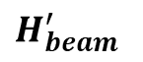
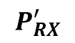
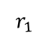
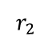
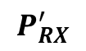
Pre-processing : Remove TX
$H_{CIR}$
Spatial transform
$H_{beam}$
$$r_{2}$$
$$r_{1}$$
1 : Find LOS
TX
$H_{beam}^{′}$
$$H_{beam}^{′}$$
(AOD x AOA x Delay)
2 : Remove TX
$$P_{RX}^{′}$$
$$r_{2}$$
$$r_{1}$$
$P_{RX}$
$$P_{RX}^{′}$$
(AOA x Delay)
Notes:
Next, We remove effect of TX in the matric H_beam . In this step, we map the reflections in H_beam to power seen by RX at diff. AOA and delays

Slide 9
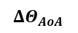
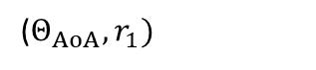
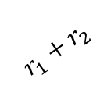
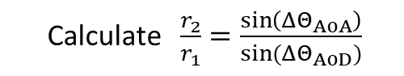
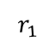
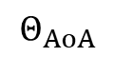
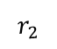
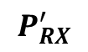
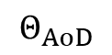
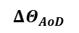
Pre-processing : Remove TX
$H_{CIR}$
Calculate $\frac{r_{2}}{r_{1}}$ $=\frac{\sin\left(ΔΘ_{AoA}\right)}{sin⁡({ΔΘ}_{AoD})}$
Spatial transform
$$r_{2}$$
$H_{beam}$
$$r_{2}$$
$$r_{1}$$
$$r_{1}$$
1 : Find LOS
TX
TX
$$ΔΘ_{AoD}$$
$H_{beam}^{′}$
$$ΔΘ_{AoA}$$
RX
$$H_{beam}^{′}$$
RX
2 : Remove TX
Project AOD to Delay
$$P_{RX}^{′}$$
$$P_{RX}^{′}$$
(AOA x Delay)
Delay
($Θ_{AoA},r_{1})$
AOD
$$r_{1}+r_{2}$$
$$Θ_{AoD}$$
$P_{RX}$
Delay
$$Θ_{AoA}$$
AOA
AOA
Notes:
The signal shown here departs TX travels r2 distance hitting an obstacle and then travels r1 distance before arriving at RX . It travels r1+r2 distance from TX, so we need to shift the delay of this entry in H_beam from r1+r2 to r1 so that it appears to arrive at RX directly from reflection point.
SO we need to calculate ratio r2/r1.
----Transition----
(laser pointer) In this triangle made from LOS path and the Current reflection , the angle delta AOD is difference between Angle of departure of LOS and of the current reflection . Delta AOA can be defined similarly. Here we use LOS parameters saved in the previous step.
Applying sine theorem we can obtain the ratio r2/r1 as ratio between sines of delta AOA to delta AOD
Now we can project entries in AOD dimension to appropriate delay to get power map from RX perspective.

Slide 10
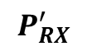
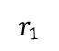
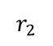
Pre-processing : Remove TX
$H_{CIR}$
Spatial transform
$H_{beam}$
$$r_{2}$$
$$r_{1}$$
1 : Find LOS
TX
$H_{beam}^{′}$
$$H_{beam}^{′}$$
(AOD x AOA x Delay)
2 : Remove TX
$$P_{RX}^{′}$$
$$r_{2}$$
$$r_{1}$$
$$P_{RX}^{′}$$
$P_{RX}$
(AOA x Delay)
Remove effect of TX by projecting AOD to Delay
Notes:
Therefore we remove the effect of TX on the RF by projecting AOD dimension to delay dimension

Slide 11
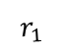
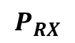
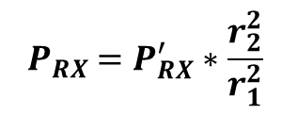
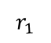
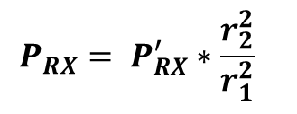
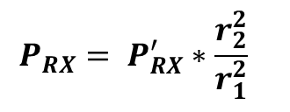
Pre-processing : Rescale Power
$H_{CIR}$
Spatial transform
$H_{beam}$
$$r_{2}$$
$$r_{1}$$
1 : Find LOS
TX
$H_{beam}^{′}$
$$H_{beam}^{′}$$
(AOD x AOA x Delay)
2 : Remove TX
$$P_{RX}^{′}$$
$${ P}_{RX} =P_{RX}^{′}∗\frac{r_{2}^{2}}{r_{1}^{2}}$$
3 : Rescale power
$$r_{2}$$
$$r_{1}$$
$$r_{1}$$
$$r_{1}$$
$$P_{RX}^{′}$$
$$P_{RX}$$
$P_{RX}$
(AOA x Delay)
(AOA x Delay)
(AOA x Delay)
Rescale to get monostatic power
Notes:
The last step remaining is to scale the power so that the reflections appear to travel the Receive path twice.
With this, we have transformed the RF data into mono static format and it’s ready to be sent to the ML model.
Shubam will now explain the ML model and results of training.

Slide 12
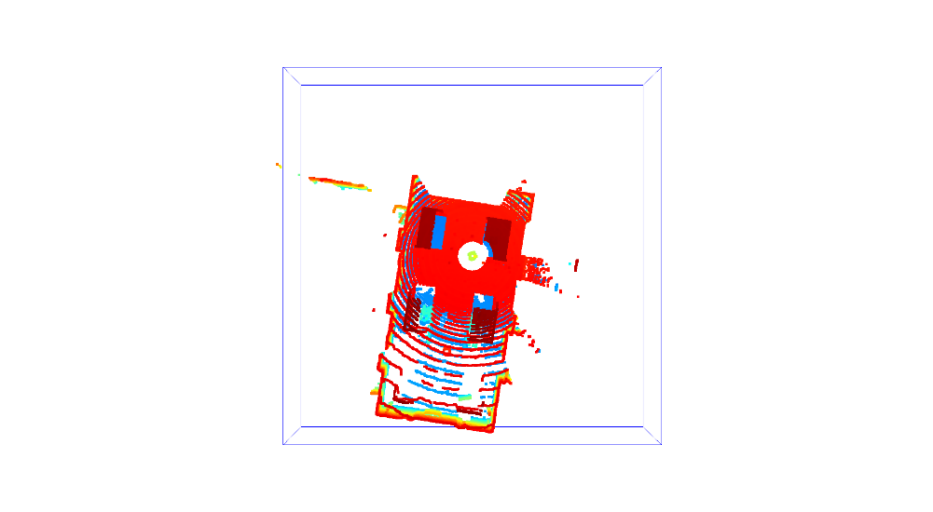
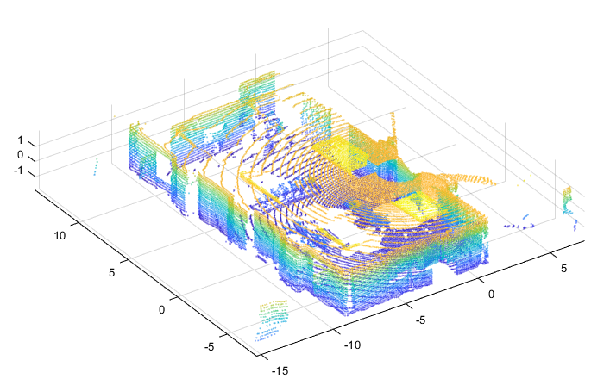
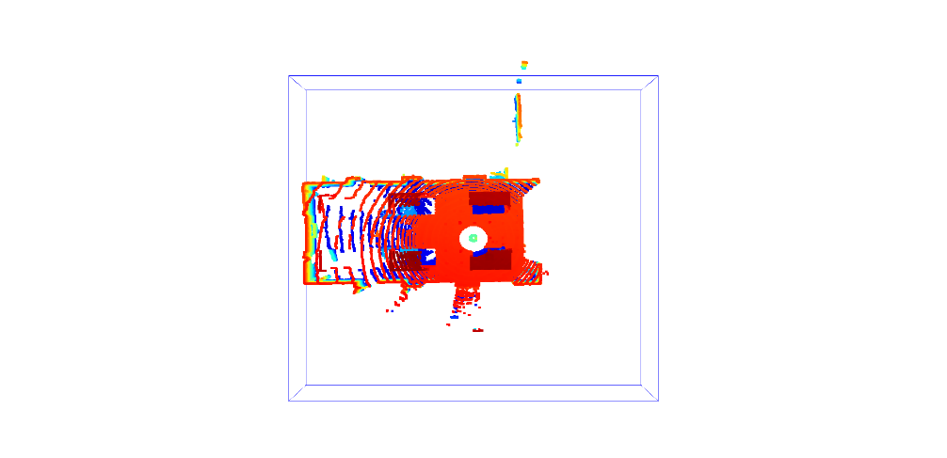
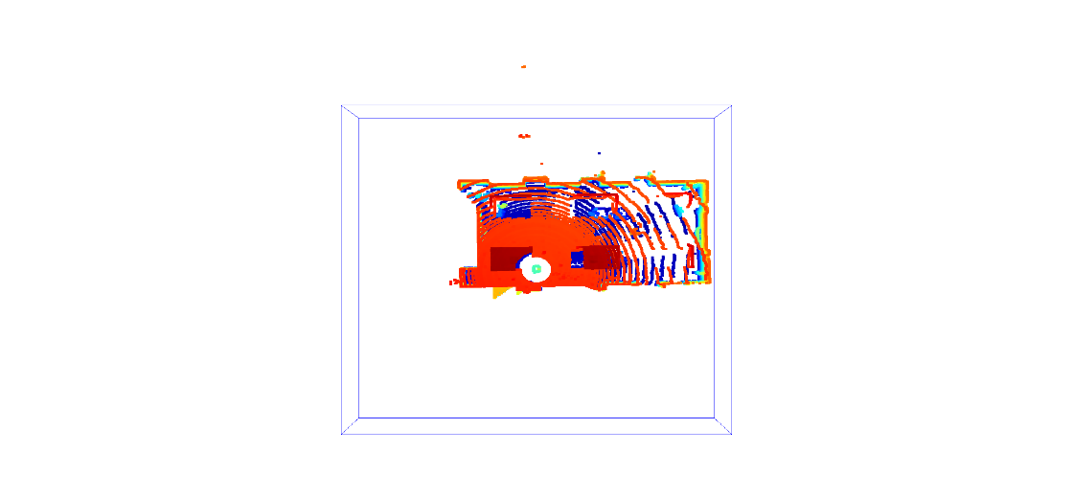
Input and Output for ML Model Training
Given Input: CIR for 64x64 MIMO
Given Output (ground truth): LIDAR PCD
(16, 16, 2)
RX
~ 35k points
[1.233, 8.342, -1.20]
[4.25, 10.57, -0.25] ….
(-16, -16, -2)
(16, 16, 2)
If a point is in voxel: Voxel value =1
Pre-processing
TX
(16, 16, 2)
(-16, -16, -2)
(16, 16, 2)
Z (m)
ML Model
Y (m)
X (m)
(-16, -16, -2)
(-16, -16, -2)
Input for the ML model:
Power of reflections from:
64 directions : (8 Az x 8 El)
Each direction 100 points*.
Output labels for ML model: Voxel Grid:
Voxel size =0.25 m -> Dim: 128 x 128 x 16
Voxel size=0.5 m -> Dim: 64x64x8
*Distance between consecutive points ~ 17cm
~ 13k voxels are 1 out of : 128 x 128 x 16 voxels

Slide 13
Solution : Why is it difficult ?
 | Pre-processed RF data | LIDAR Data
Data | Power values @ 100 points x 64 directions (8 Az x 8 El) | Co-ordinates @ 35k pts of reflections
Range resolution | 0.17 m | 10^-6 m
Angle resolution | Low (~ 22.5 º ) | High
I/O Dimension | 6400x1 | 262k (voxel grid: 128x128x16)
Z (m)
RF
Y (m)
X (m)
ML Model
Lidar
Notes:
To generate such model, lets look at the how the mimo data is generated and how lidar data is generated.
As you can see, MIMO data is in what we call bistatic mode i.e the transmission & reception are physically separable locations.
Whereas Lidar sends and receives laser light signals from the same location.
In essence, we are attempting to take MIMO channel data that is bi-static (physically separable TX, RX) and fit it to LIDAR data that is mono static (same antenna as TX & RX).
Why do you need to transform to mono static data before sending to ML?
We wanted to make the training part of model more simpler & explainable . If not done, model should be itself learn about existence of MIMO TX and its location and other features thorough a large amount of training data which is of-course not guaranteed and depends on ML architecture.
So Pre-processing step handles the deterministic aspects of transforming MIMO channel data which is a function of TX, RX, environment to Lidar data which is function of RX, environment.
In addition, we wanted to handle the deterministic aspects of model fitting like data transformations outside the DL model training.
Since we are aware of what part of model learns what? this makes improving the overall model with further additional features much easier.

Slide 14
ML model architecture
From Pre-processing step:
Motivation behind used layers:
Input dim =6400, Output dim=128x128x16=2,62,000
Ratio I/O=3% -> Up-sampling layer
Correlation in reflections exists in close neighbourhood
-> CNN is used
Z (m)
Y (m)
X (m)

Slide 15
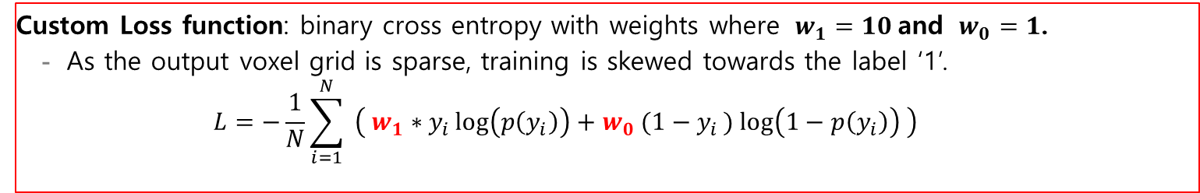
Training parameters
Custom Loss function: binary cross entropy with weights where $w_{1}=10$and $w_{0}=1$.
As the output voxel grid is sparse, training is skewed towards the label ‘1’.
$$L=−\frac{1}{N}\sum_{i=1}^{N}{ \left( w_{1}∗y_{i}\log\left(p\left(y_{i}\right)\right)+w_{0} (1−y_{i}) log\left(1−p\left(y_{i}\right)\right) \right)}$$
Dataset:
Total training samples : 3400 samples
Area 1 : 2400 samples
Area 3: 1000 samples
Validation samples : 350 (consisting of both the areas)
Test data: 529 sample of Area 2
RX
Testing samples
Training samples
Optimizer:
Adam with learning rate of 0.0005
Decay rate: 0.9 every 10000 steps
Epochs =100, batch size : 32.
TX

Slide 16
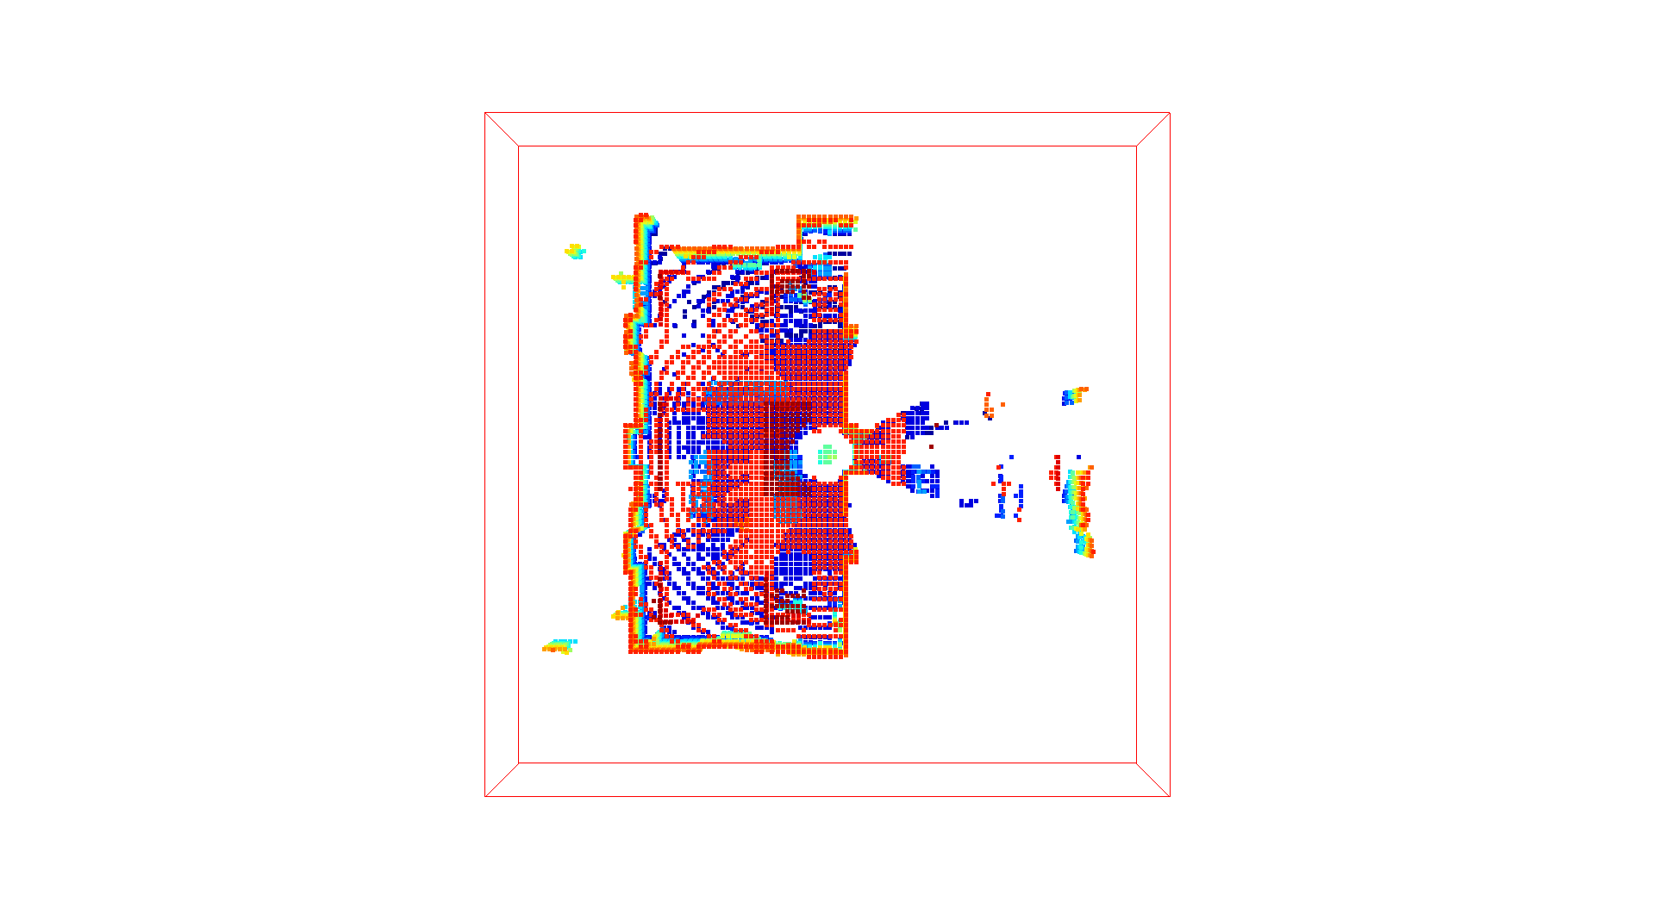
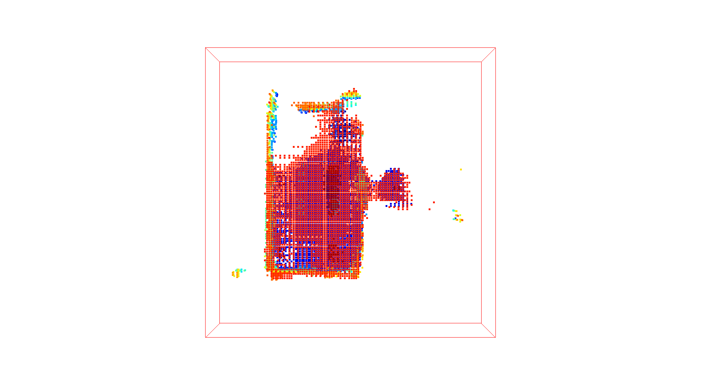
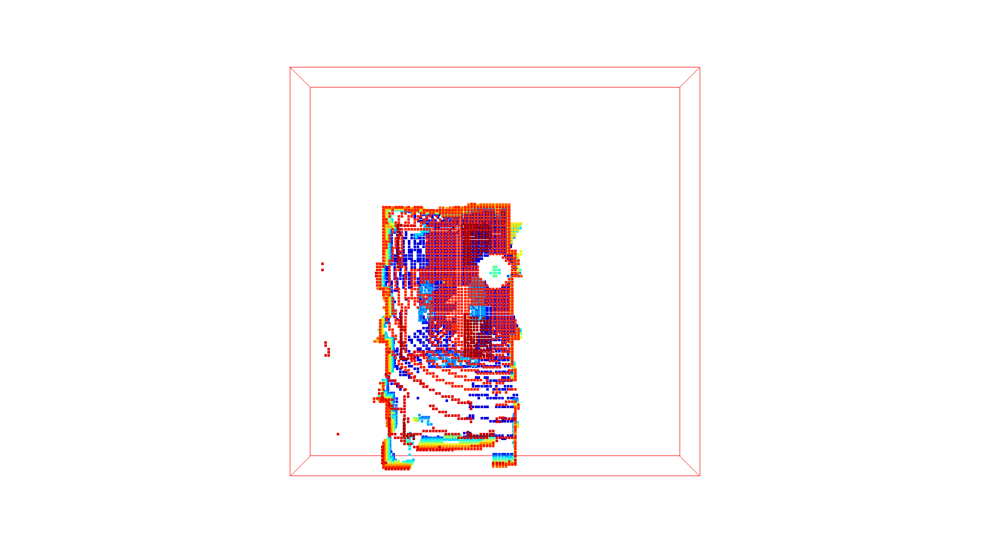
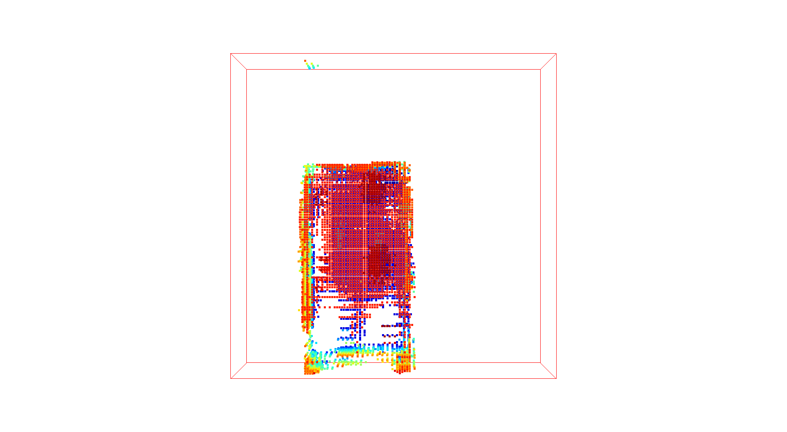
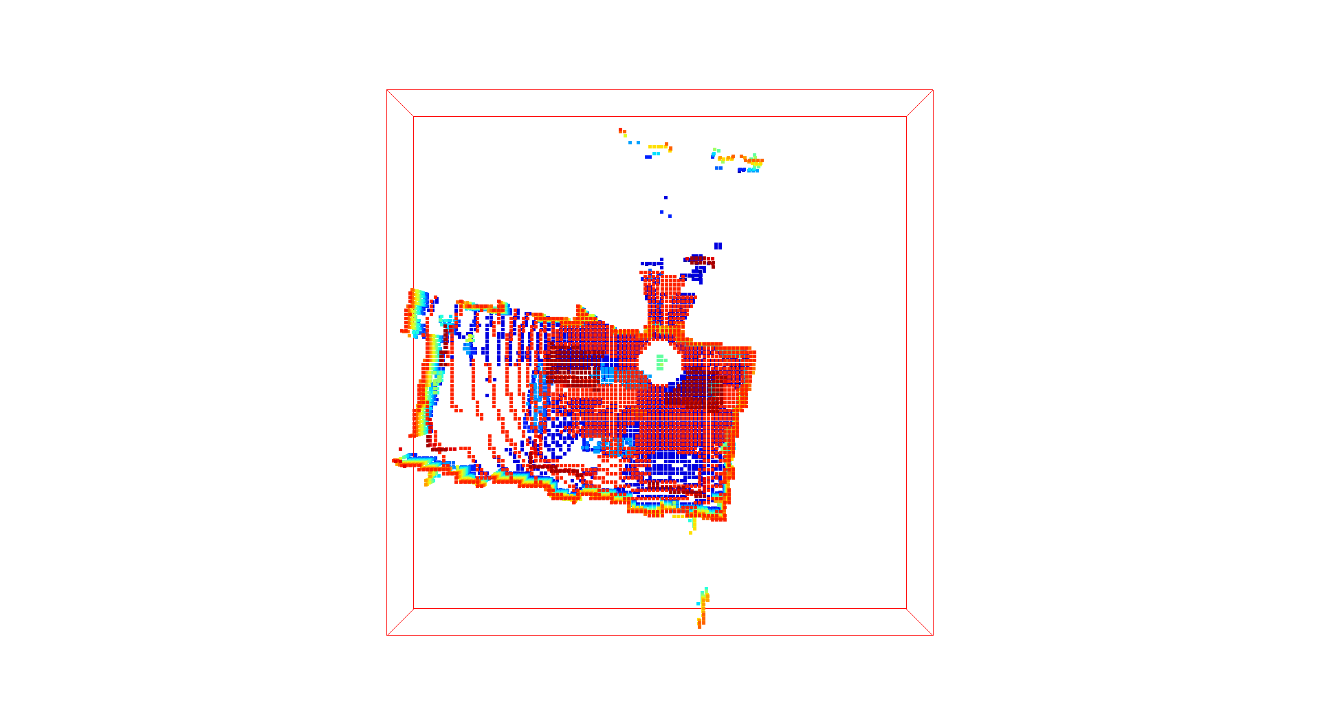



Prediction vs Actual PCD
LIDAR PCD | Predicted PCD
LIDAR PCD | Predicted PCD
(16, 16, 2)
(16, 16, 2)
(-16, -16, -2)
(-16, -16, -2)
(16, 16, 2)
(16, 16, 2)
(-16, -16, -2)
(-16, -16, -2)
Estimated Depth Map similar to LIDAR PCD.
Change in perception across locations, is nicely captured.
Notes:
Perception change with location is nicely captured
Perception of the room changes with location and orientation of the receiver. This qualitative behaviour is nicely captured in the predicted PCD.

Slide 17




Evaluation Metric for the challenge
Input Data: RF Data Evaluation Dataset
Trained Model
Output: LiDAR Point Clouds
Evaluation
Ground Truth: LiDAR Evaluation dataset
Chamfer Distance
measures discrepancies between point clouds.
$$d_{CD}\left(S_{1},S_{2}\right)=\frac{1}{{\left|S_{1}\right|}_{ }}\sum_{x ∈S_{1}}{\min_{y ∈S_{2}}{{\left\|x−y\right\|}_{2}^{2}}}+\frac{1}{{\left|S_{2}\right|}_{ }}\sum_{y ∈S_{2}}{\min_{x ∈S_{1}}{{\left\|x−y\right\|}_{2}^{2}}}$$
Predicted PCD:
LIDAR PCD:

Slide 18




Evaluation : Error Analysis on Testing Data
Tx
Tx
Chamfer distance for Testing data
Average chamfer distance = $2{ m}^{2}$ which is good for the room of size ̴16 m x 16 m x 4 m
Average Chamfer distance = 1 ${ m}^{2}$ for the samples which are closer to the Tx.
Chamfer distance for Training data
Average chamfer distance = $1.5 m^{2}$ for voxel-size=0.25 m
Average Chamfer distance = 2.2 ${ m}^{2}$ for voxel-size=0.5 m

Slide 19

Conclusion and Future work..
Observations:
Estimated Depth Map similar to LIDAR PCD.
Change in perception across locations, is nicely captured.
Average chamfer distance = $2{ m}^{2}$ which is good for the room of size ̴16 m x 16 m x 4 m
Average Chamfer distance = 1 ${ m}^{2}$ for the samples which are closer to the Tx.
Future Work :
Using Multi-path components instead of CIR as input.
Global training inclusive of all the locations
Experiment with the Voxel grid size
Train using Tx perspective along with Rx perspective
Thank you.
Questions ?
We thank the NIST, USA and ITU challenge team for providing exciting problem.

